Slide 1

Analysis of 6 Input Methods for TankMania!
By Janosch Landvogt, Chang Luo, Mykola Morozov, Raoul Zebisch
Dreidimensionale Nutzerschnittstellen (IN2111)
Prof. Dr. Klinker, M.Sc. Dyrda

Slide 2
Input Method Explanation
Prof. Dr. Klinker, M.Sc. Dyrda | Dreidimensionale Nutzerschnittstellen (IN2111)

Slide 3
Survey Demographic Data
Prof. Dr. Klinker, M.Sc. Dyrda | Dreidimensionale Nutzerschnittstellen (IN2111)

Slide 4
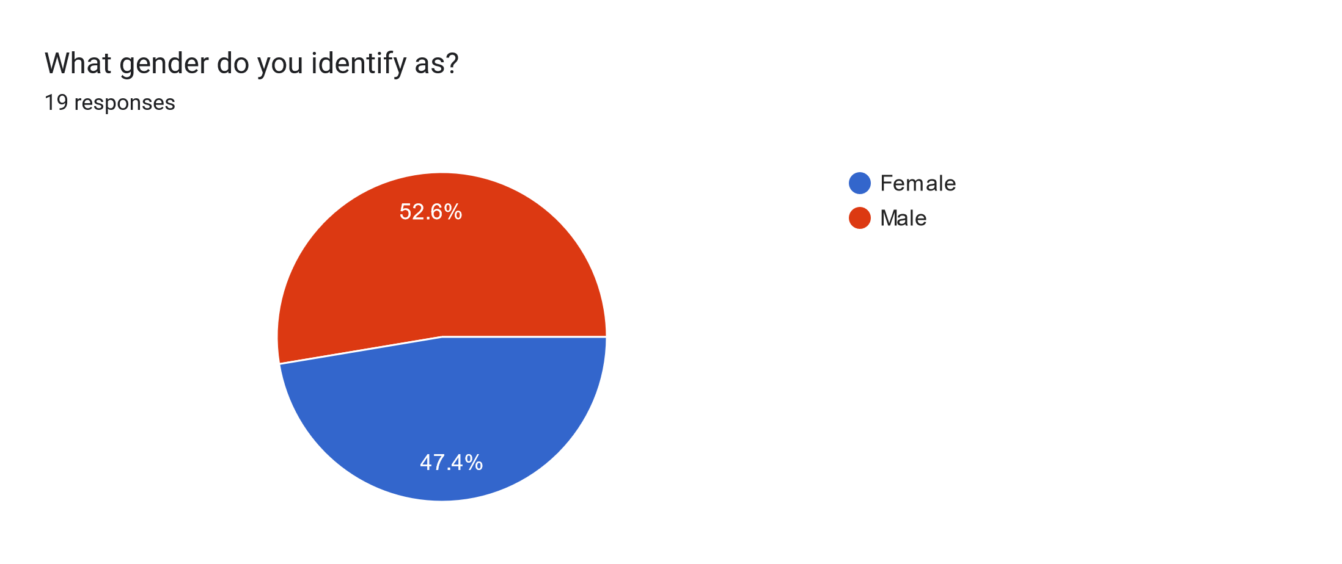
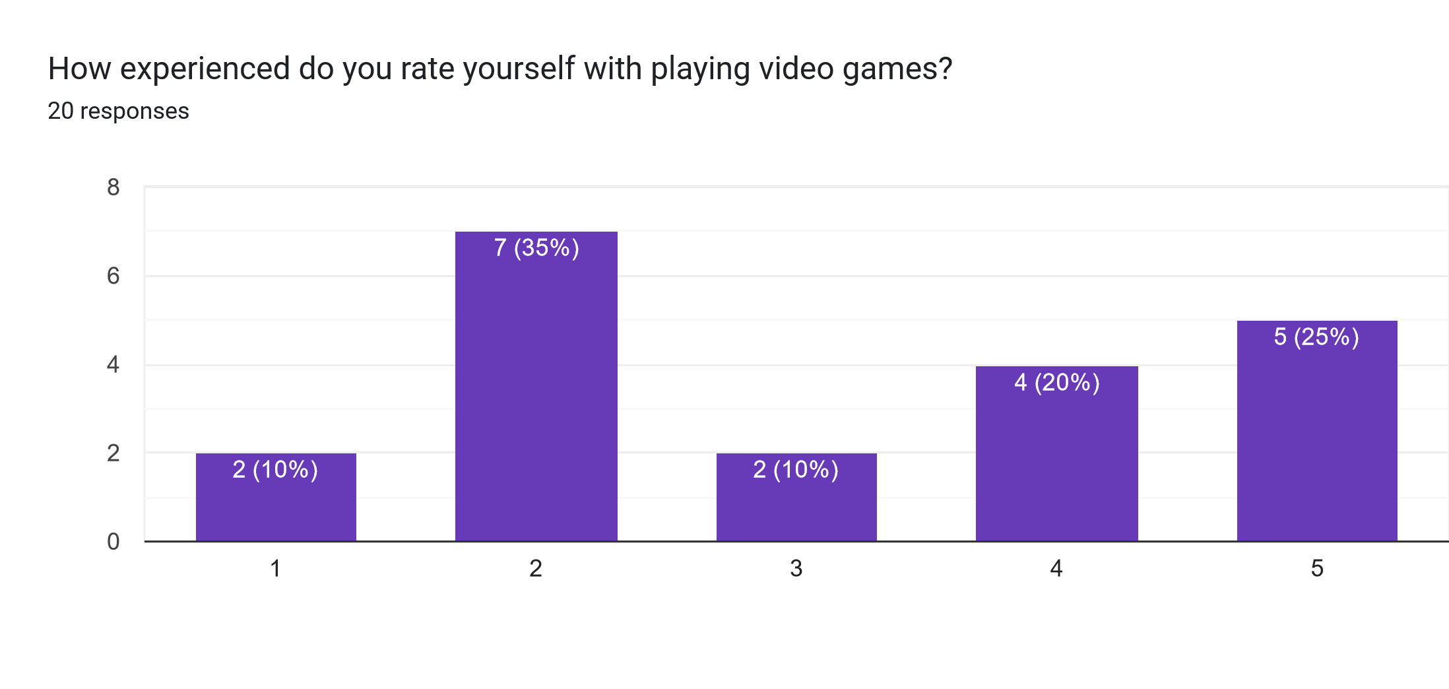
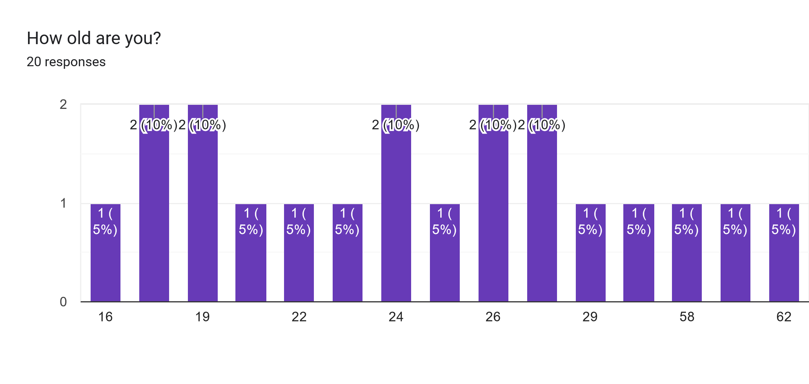
Never played Played some games Played occasionally Played quite often Played for years
Prof. Dr. Klinker, M.Sc. Dyrda | Dreidimensionale Nutzerschnittstellen (IN2111)

Slide 5
Best Input Method for TankMania!
Prof. Dr. Klinker, M.Sc. Dyrda | Dreidimensionale Nutzerschnittstellen (IN2111)

Slide 6
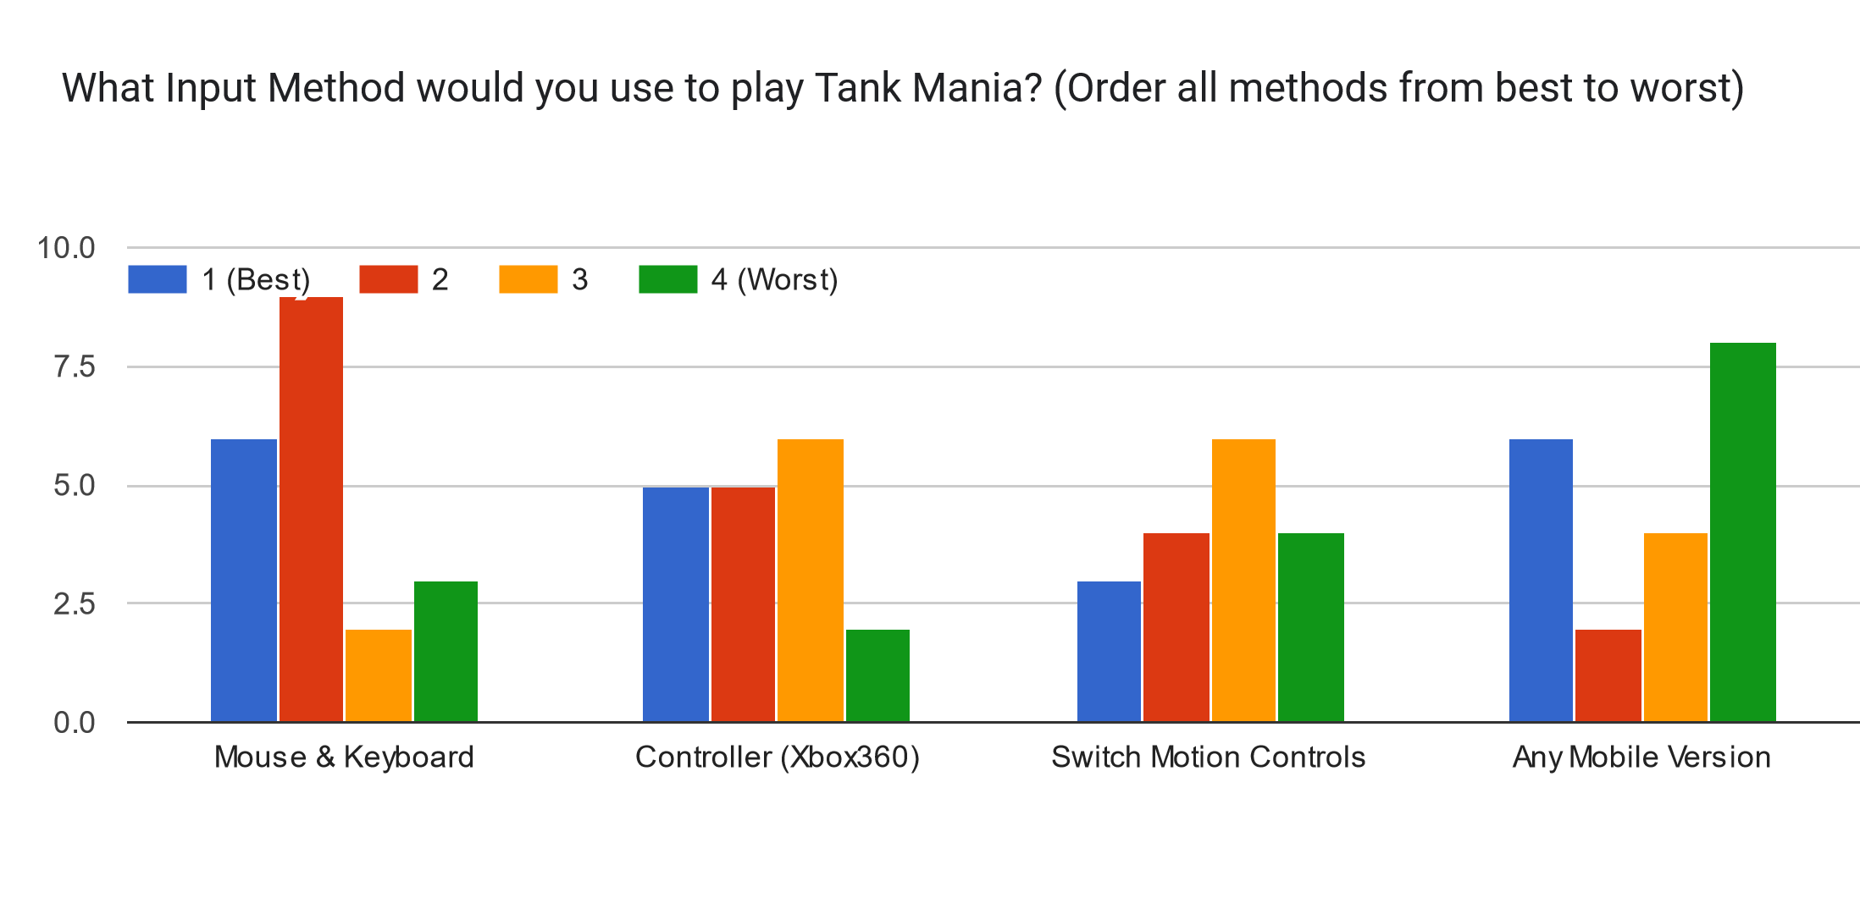
Prof. Dr. Klinker, M.Sc. Dyrda | Dreidimensionale Nutzerschnittstellen (IN2111)

Slide 7
1st Mouse&Keyboard (6) Mobile (6) Controller (5) Switch (3)
Prof. Dr. Klinker, M.Sc. Dyrda | Dreidimensionale Nutzerschnittstellen (IN2111)

Slide 8
1st Mouse&Keyboard (6) Mobile (6) Controller (5) Switch (3) | 2nd Mouse&Keyboard (9) Controller (5) Switch (4) Mobile (2)
Prof. Dr. Klinker, M.Sc. Dyrda | Dreidimensionale Nutzerschnittstellen (IN2111)

Slide 9
1st Mouse&Keyboard (6) Mobile (6) Controller (5) Switch (3) | 2nd Mouse&Keyboard (9) Controller (5) Switch (4) Mobile (2) | 3rd Controller (6) Switch (6) Mobile (4) Mouse&Keyboard (2)
Prof. Dr. Klinker, M.Sc. Dyrda | Dreidimensionale Nutzerschnittstellen (IN2111)

Slide 10
1st Mouse&Keyboard (6) Mobile (6) Controller (5) Switch (3) | 2nd Mouse&Keyboard (9) Controller (5) Switch (4) Mobile (2) | 3rd Controller (6) Switch (6) Mobile (4) Mouse&Keyboard (2) | 4th Mobile (8) Switch (4) Mouse&Keyboard (3) Controller (3)
Prof. Dr. Klinker, M.Sc. Dyrda | Dreidimensionale Nutzerschnittstellen (IN2111)

Slide 11
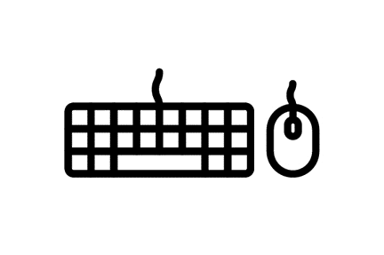




1st Mouse&Keyboard (6) Mobile (6) Controller (5) Switch (3) | 2nd Mouse&Keyboard (9) Controller (5) Switch (4) Mobile (2) | 3rd Controller (6) Switch (6) Mobile (4) Mouse&Keyboard (2) | 4th Mobile (8) Switch (4) Mouse&Keyboard (3) Controller (3)
2,1
2,37
2,65
2,7
Prof. Dr. Klinker, M.Sc. Dyrda | Dreidimensionale Nutzerschnittstellen (IN2111)

Slide 12
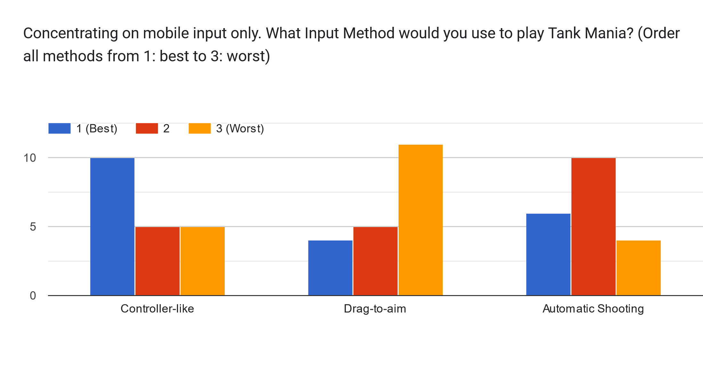
1st
2nd
3rd
Prof. Dr. Klinker, M.Sc. Dyrda | Dreidimensionale Nutzerschnittstellen (IN2111)

Slide 13
Correlation Best-Rated and Main-Input

Slide 14
→ Most people chose their main go-to input method as their favorite input method to play TankMania!
Prof. Dr. Klinker, M.Sc. Dyrda | Dreidimensionale Nutzerschnittstellen (IN2111)

Slide 15
Winners by Category

Slide 16
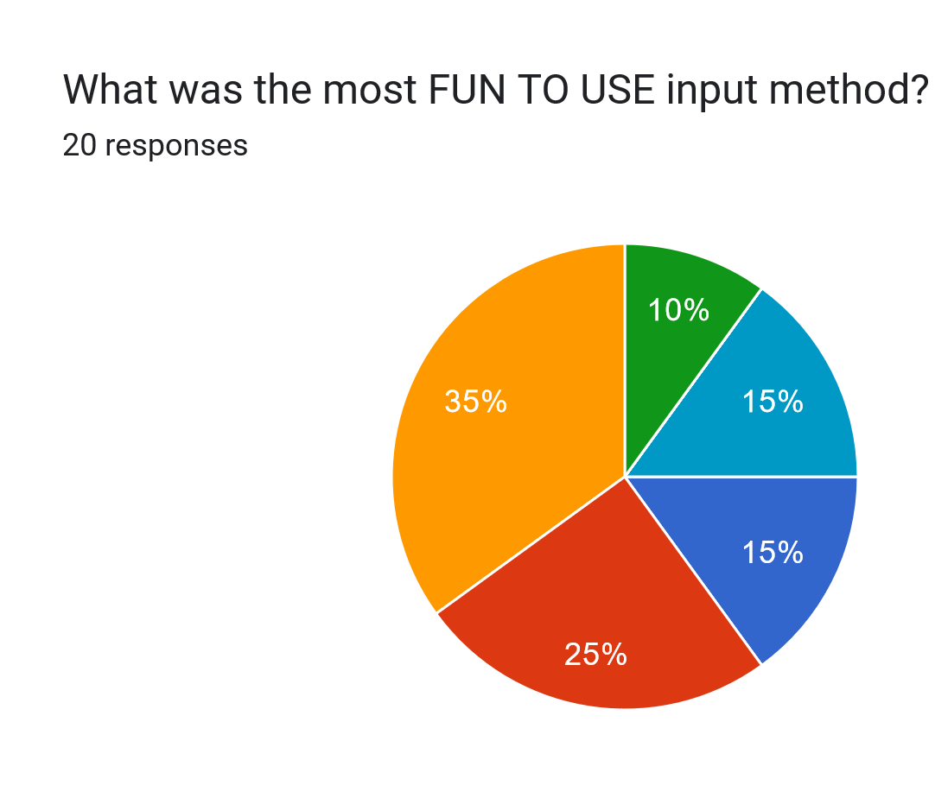
Automatic Shooting
Prof. Dr. Klinker, M.Sc. Dyrda | Dreidimensionale Nutzerschnittstellen (IN2111)

Slide 17
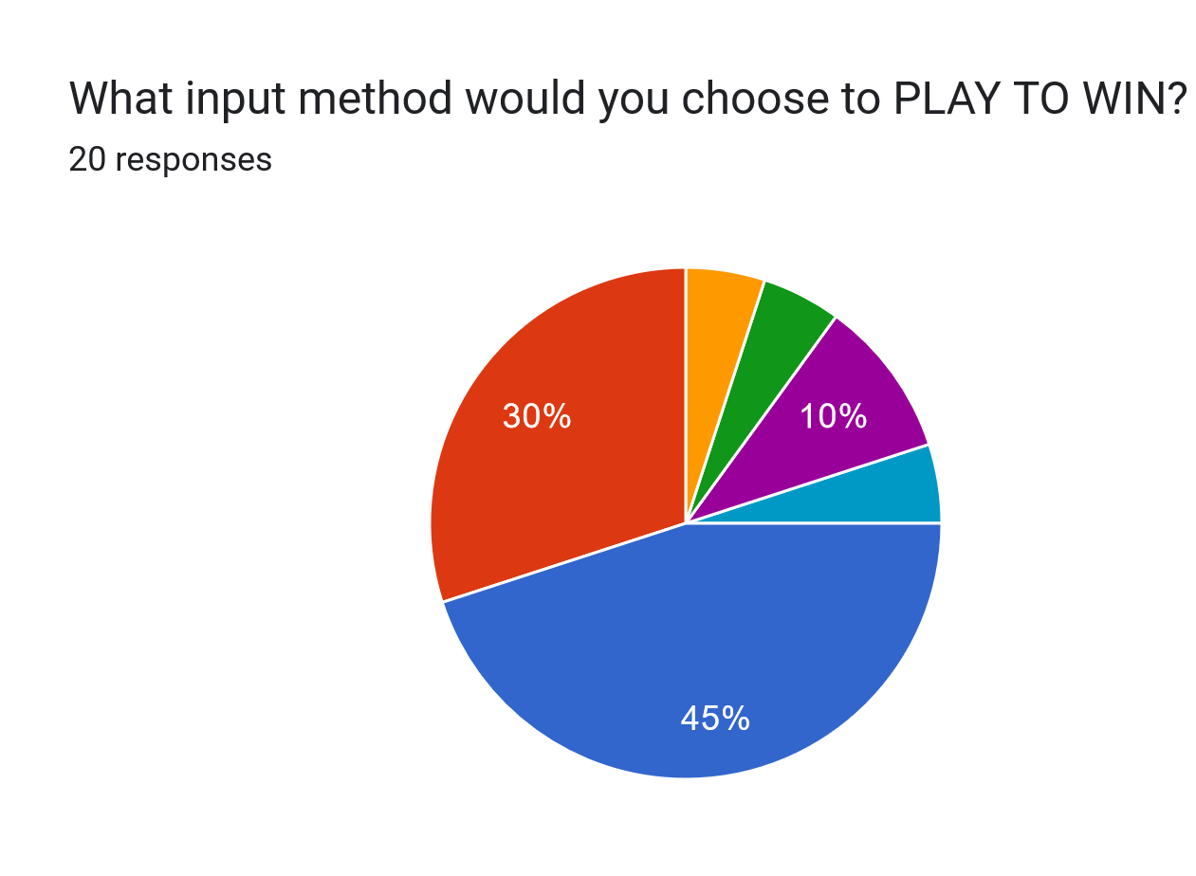
Drag-to-aim
Prof. Dr. Klinker, M.Sc. Dyrda | Dreidimensionale Nutzerschnittstellen (IN2111)

Slide 18
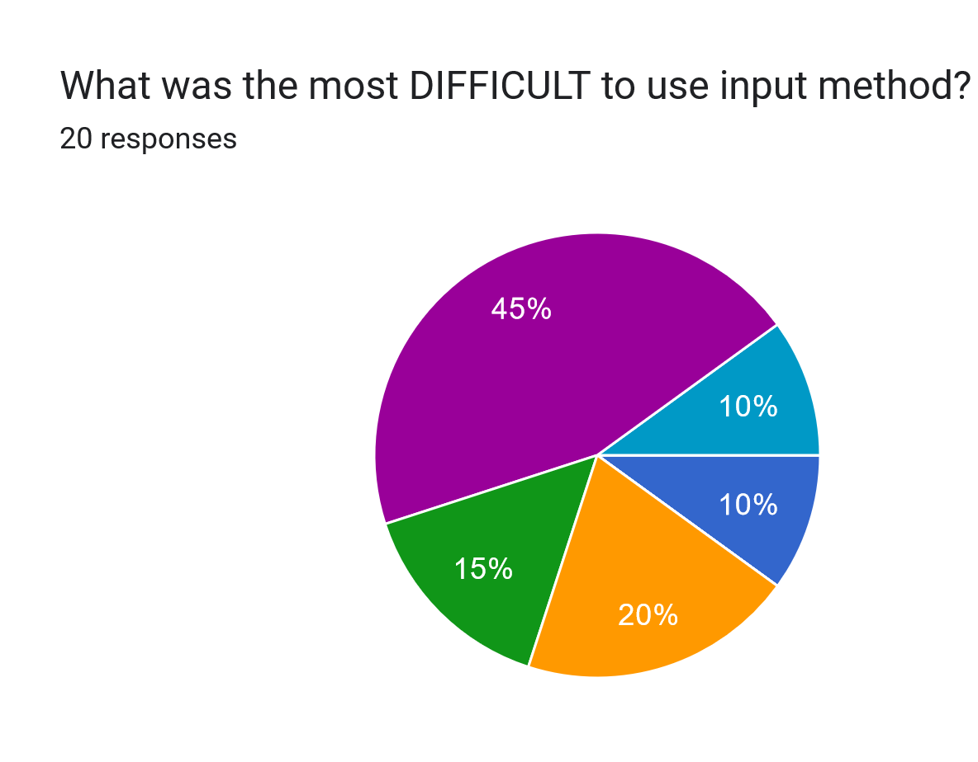
Drag-to-aim
Prof. Dr. Klinker, M.Sc. Dyrda | Dreidimensionale Nutzerschnittstellen (IN2111)

Slide 19
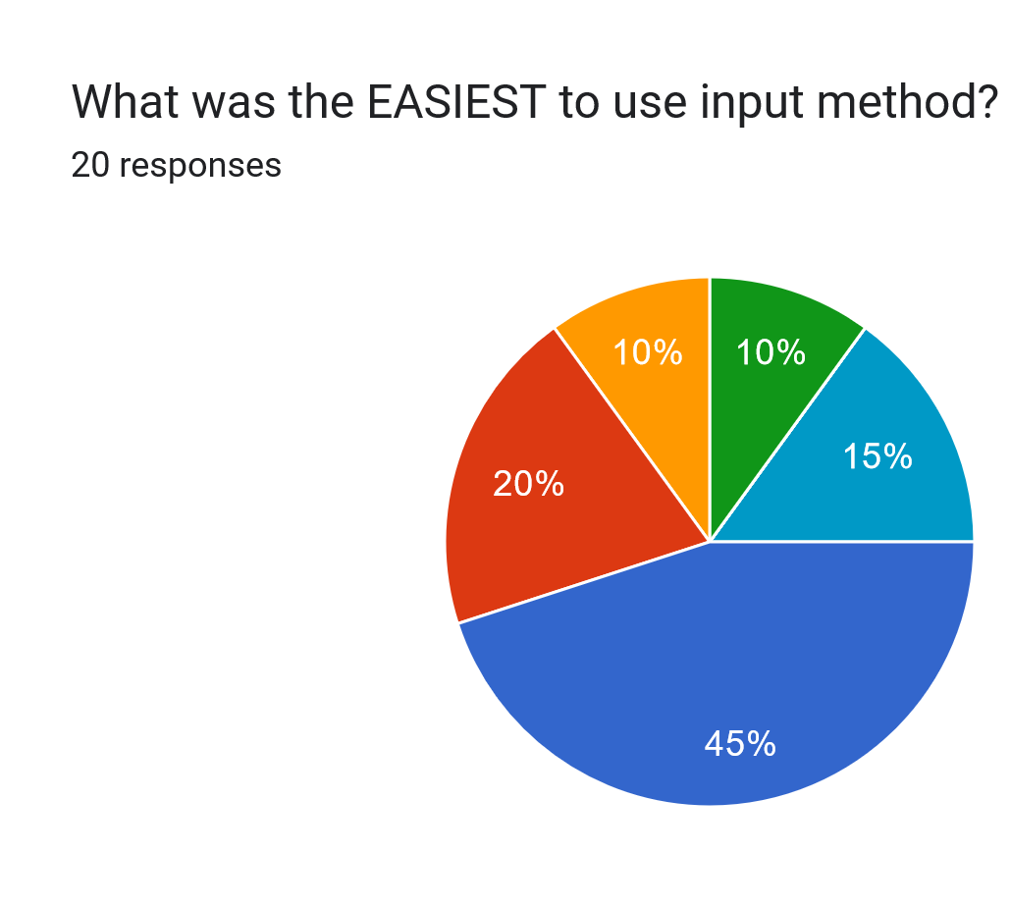
Automatic Shooting
Prof. Dr. Klinker, M.Sc. Dyrda | Dreidimensionale Nutzerschnittstellen (IN2111)

Slide 20
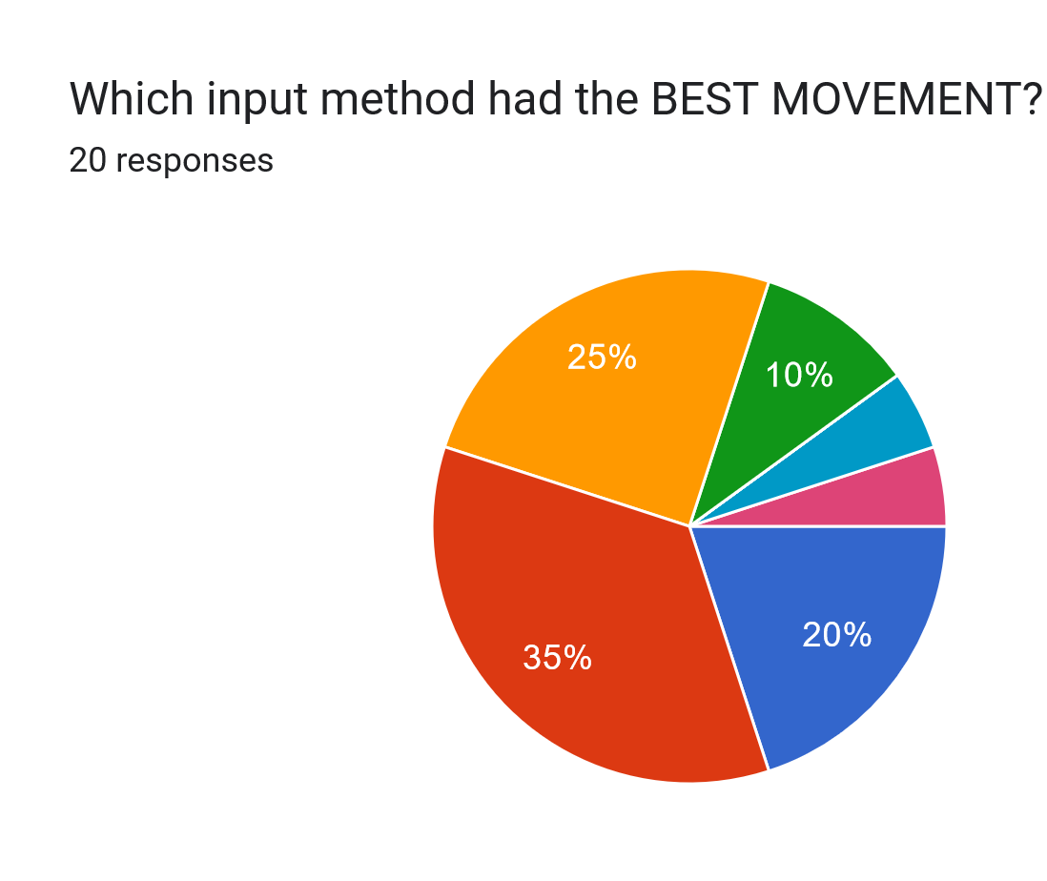
Controller-like
Can‘t decide
Prof. Dr. Klinker, M.Sc. Dyrda | Dreidimensionale Nutzerschnittstellen (IN2111)

Slide 21
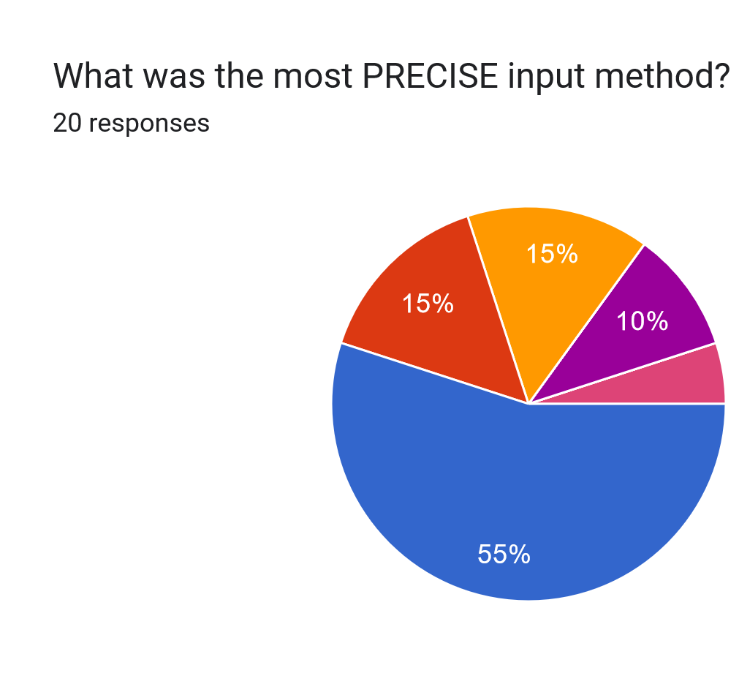
Drag-to-aim
Can‘t decide
Prof. Dr. Klinker, M.Sc. Dyrda | Dreidimensionale Nutzerschnittstellen (IN2111)

Slide 22
Contribution

